Slide 1
ALL YOU NEED
TO SIGN UP.
Download the app
﻿﻿Have your declarations page ready
﻿﻿Have your license ready
﻿﻿Get a referral code from your friend
Join in under 10 minutes!

Slide 2
I saved
$512
*
with Good Driver Club.
*The savings of 40% are not guaranteed and actual savings may depend on the driving behavior of the community.

Slide 3
At first I was skeptical of
Good Driver Club.
Now, 6 months later,
I've saved
$435
*
and I'm ready to
renew and do it all again!
*The savings of 40% are not guaranteed and actual savings may depend on the driving behavior of the community.

Slide 4
I referred a friend to Good Driver Club
and instantly earned
$107
once they joined.

Slide 5
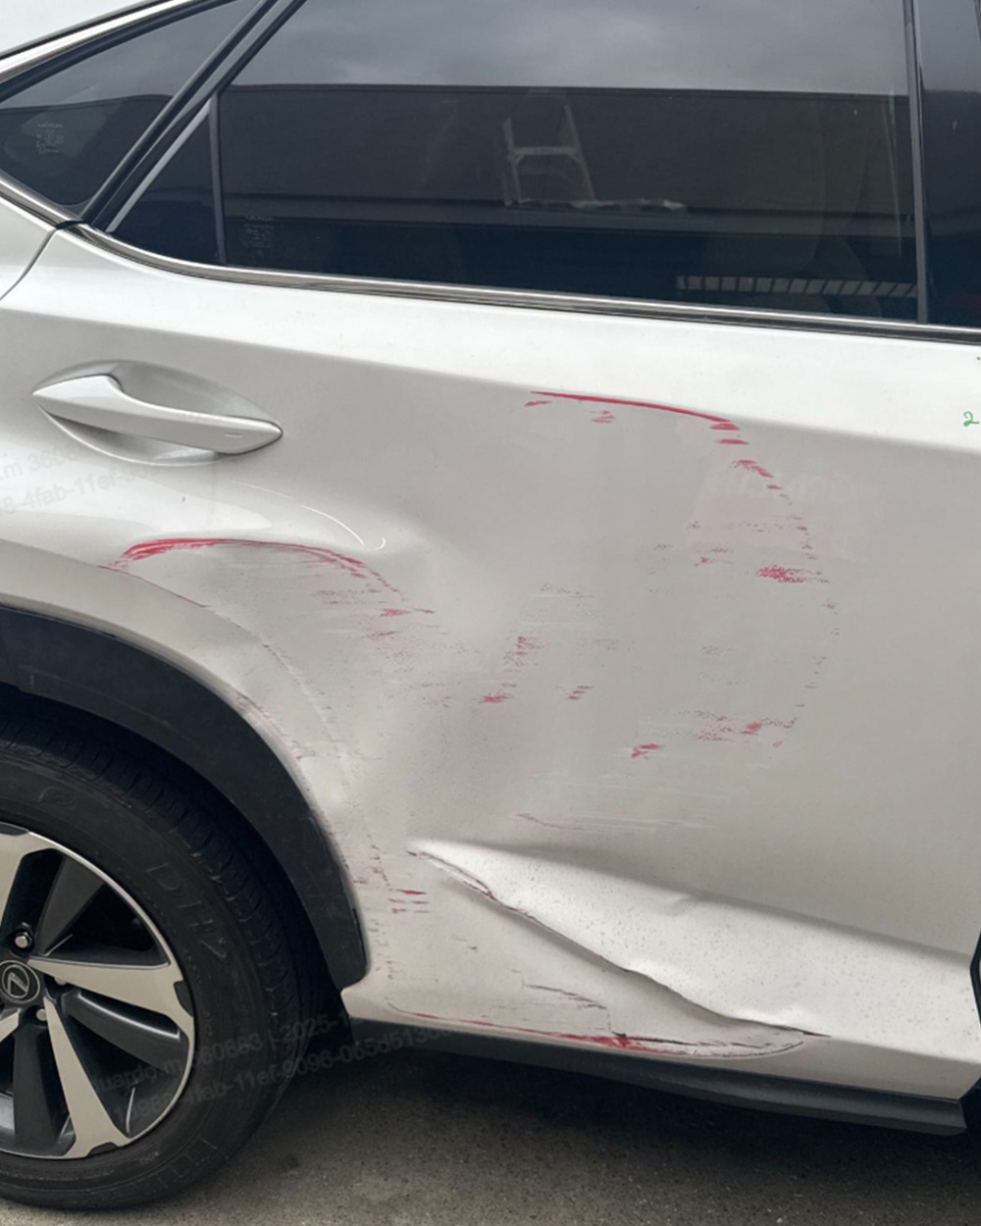
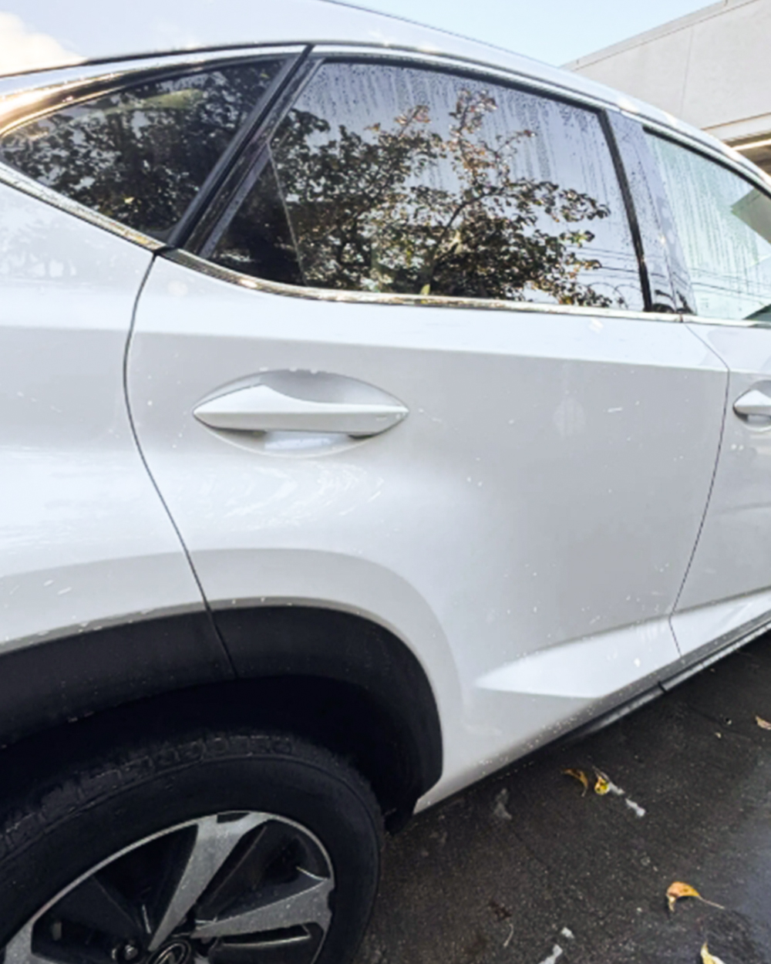
Good Driver Club was there when
I needed support.
BEFORE
AFTER
They got me my car back.
It looks brand new!
The GDC Program is not an insurance that guarantees loss payment. It is a community-based auto loss sharing program. GDC Program may use non-OEM parts for repairs when appropriate. Except for key safety components, OEM parts may not be used if quality alternatives are available. These parts may differ in fit, finish, or warranty coverage.

